Slide 1
Transport of Intensity based Quantitative Phase Imaging
Progression Report

Slide 2
Propagating the phase object
So far, we have redesigned the simulation code for propagation through 4f system. We added options to draw graphs on request and added scoping to the code, so it is more easily read and simpler to understand.
Using the propagation code, we attempted to simulate propagation of light passing through a phase object, and reconstructing the phase using TIE.
We will present the result we achieved so far. Currently, they are not sufficient to extract the information on the phase, and we will proceed to address this.

Slide 3
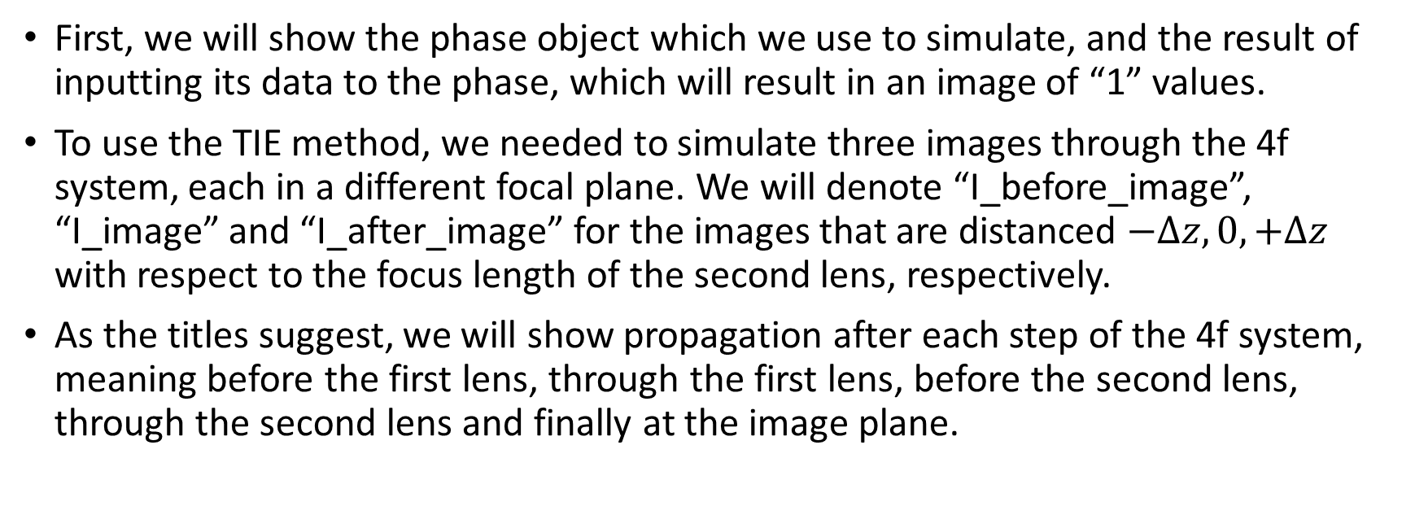
Propagation Through 4f System
First, we will show the phase object which we use to simulate, and the result of inputting its data to the phase, which will result in an image of “1” values.
To use the TIE method, we needed to simulate three images through the 4f system, each in a different focal plane. We will denote “I_before_image”, “I_image” and “I_after_image” for the images that are distanced $−Δz,0,+Δz$ with respect to the focus length of the second lens, respectively.
As the titles suggest, we will show propagation after each step of the 4f system, meaning before the first lens, through the first lens, before the second lens, through the second lens and finally at the image plane.

Slide 4
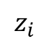
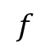
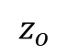
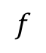
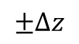
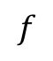
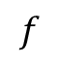
Schematic of the Simulated System
The system we simulated is a standard 4f system, with a clear SLM for start, and could be visually described as follows:
$$f$$
$$f$$
CCD
$$f$$
$$f$$
CCD
CCD
LASER
Phase object
$$±Δz$$
$$z_{o}$$
$$z_{i}$$

Slide 5
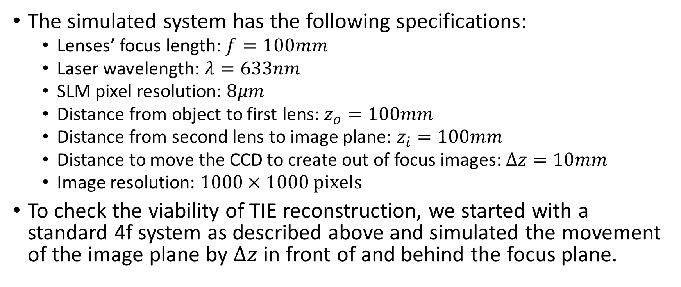
System Specifications
The simulated system has the following specifications:
Lenses’ focus length: $f=100mm$
Laser wavelength: $λ=633nm$
SLM pixel resolution: $8μm$
Distance from object to first lens: $z_{o}=100mm$
Distance from second lens to image plane: $z_{i}=100mm$
Distance to move the CCD to create out of focus images: $Δz=10mm$
Image resolution: $1000×1000 \text{pixels}$
To check the viability of TIE reconstruction, we started with a standard 4f system as described above and simulated the movement of the image plane by $Δz$ in front of and behind the focus plane.

Slide 6
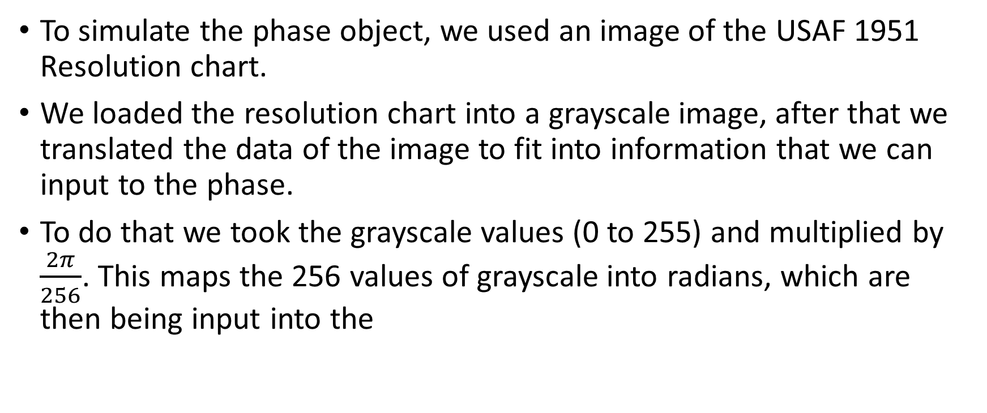
Simulating the Phase Object
To simulate the phase object, we used an image of the USAF 1951 Resolution chart.
We loaded the resolution chart into a grayscale image, after that we translated the data of the image to fit into information that we can input to the phase.
To do that we took the grayscale values (0 to 255) and multiplied by $\frac{2π}{256}$. This maps the 256 values of grayscale into radians, which are then being input into the

Slide 7
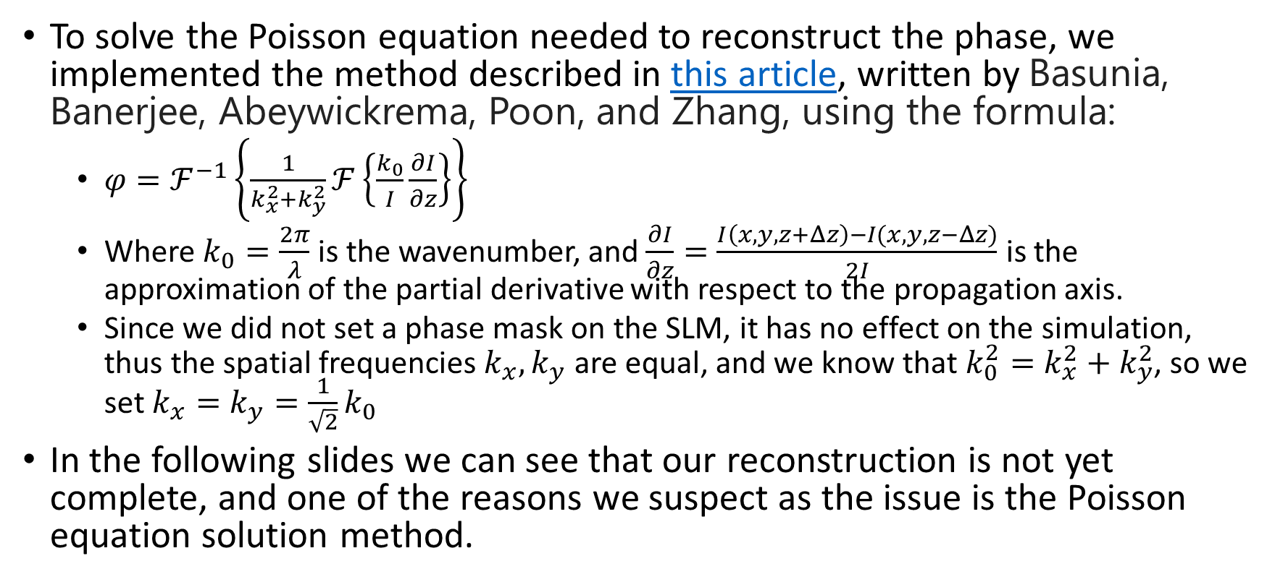
Solving the Poisson Equation
To solve the Poisson equation needed to reconstruct the phase, we implemented the method described in this article, written by Basunia, Banerjee, Abeywickrema, Poon, and Zhang, using the formula:
$φ=ℱ^{−1}\left\{\frac{1}{k_{x}^{2}+k_{y}^{2}}ℱ\left\{\frac{k_{0}}{I}\frac{∂I}{∂z}\right\}\right\}$
Where $k_{0}=\frac{2π}{λ}$ is the wavenumber, and $\frac{∂I}{∂z}=\frac{I\left(x,y,z+Δz\right)−I(x,y,z−Δz)}{2I}$ is the approximation of the partial derivative with respect to the propagation axis.
Since we did not set a phase mask on the SLM, it has no effect on the simulation, thus the spatial frequencies $k_{x},k_{y}$ are equal, and we know that $k_{0}^{2}=k_{x}^{2}+k_{y}^{2}$, so we set $k_{x}=k_{y}=\frac{1}{\sqrt{2}}k_{0}$
In the following slides we can see that our reconstruction is not yet complete, and one of the reasons we suspect as the issue is the Poisson equation solution method.

Slide 8
Phase Object

Slide 9
I_before_image

Slide 10
I_image

Slide 11
I_after_image

Slide 12
Reconstructed Phase
We used the TIE method to extract the data on the phase from the intensity of the image. The following result is not sufficient, yet we can still see a pattern resembling the original phase object we used.

